Slide 1
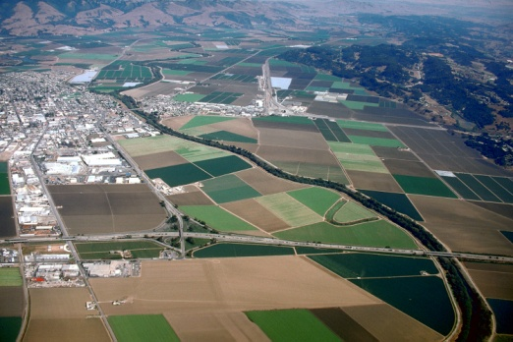
CalWORKs Housing Support Program County of Santa Cruz
Jessica Scheiner & Kathy Mello
April 7, 2015

Slide 2
Target Population
CalWORKs Welfare-To-Work (WTW) eligible
Literally homeless
Middle group in terms of need
Priority 1: shelter residents
Priority 2: on shelter waitlist

Slide 3
The Team
Homeless Services Center & Pajaro Valley Shelter Services
Referrals
Families In Transition
Housing identification & location
County HSD
Referrals
Eligibility determinations
Case management
Housing identification & location
Housing retention assistance
Administration of financial assistance
Eligibility determinations
Program design
Oversight
Family Stabilization Program & CW WTW services
Coordination
Problem Solving
Cheerleading
Outreach to landlords

Slide 4
Process – Initial Referral
- If no case management availability: waitlist
- If yes case management availability: eligibility determination
County refers homeless CW WTW families
Partners refer homeless families

Slide 5
Process – Check for Basic Eligibility
County confirms CW WTW eligibility of partner referred families
Nonprofits confirm homeless status and shelter residency/waitlist of County referred families
If no, continue working w/family
If yes, final eligibility determination

Slide 6
Process – Final Eligibility Determination
needs > 1 month rental assistance
Self-supporting <18 months assistance
CW HSP Family
Homeless CW WTW Eligible family

Slide 7
Process – Housing
Prep for landlord meetings
Housed!
Housing search
Housing Assessment
- Max rent
- Location
Meet w/landlords

Slide 8
Once housed…
Ongoing case manager-client meetings
Weekly at first
Decreasing with stabilization
At least monthly
Ongoing landlord relationship maintenance
Develop good tenant skills
Mediate tenant-landlord issues
If necessary, move clients before burning landlord relationship

Slide 9
Financial Assistance
Whatever rental, pet, utility,...deposit is required to get family housed
Rental assistance
Max 18 months
Declining over time based on monthly assessments
Smallest subsidy possible
Later additions to program
Furniture
Past utility and rent payments
Individualized assistance to break down barriers to housing

Slide 10
Challenges
Flying the plane while building it
The givens
High housing costs/low vacancy rates
Poor/no credit, rental, and/or employment history
Some families a little rough around the edges
Blind faith regarding year 2
Continued family assistance
Contractor payments
Push for numbers
Contractor issues
Learning process across homeless service agencies and County

Slide 11
Successes
Incredible opportunity…
House and stabilize families
Support families towards self-sufficiency
Coordination/relationship building across homeless service agencies and County
F-SPDAT assessment system – training and inaugural users
Introducing HMIS to County
Initial piece of coordinated entry system development

Slide 12
HOPE

